Slide 1
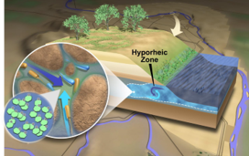
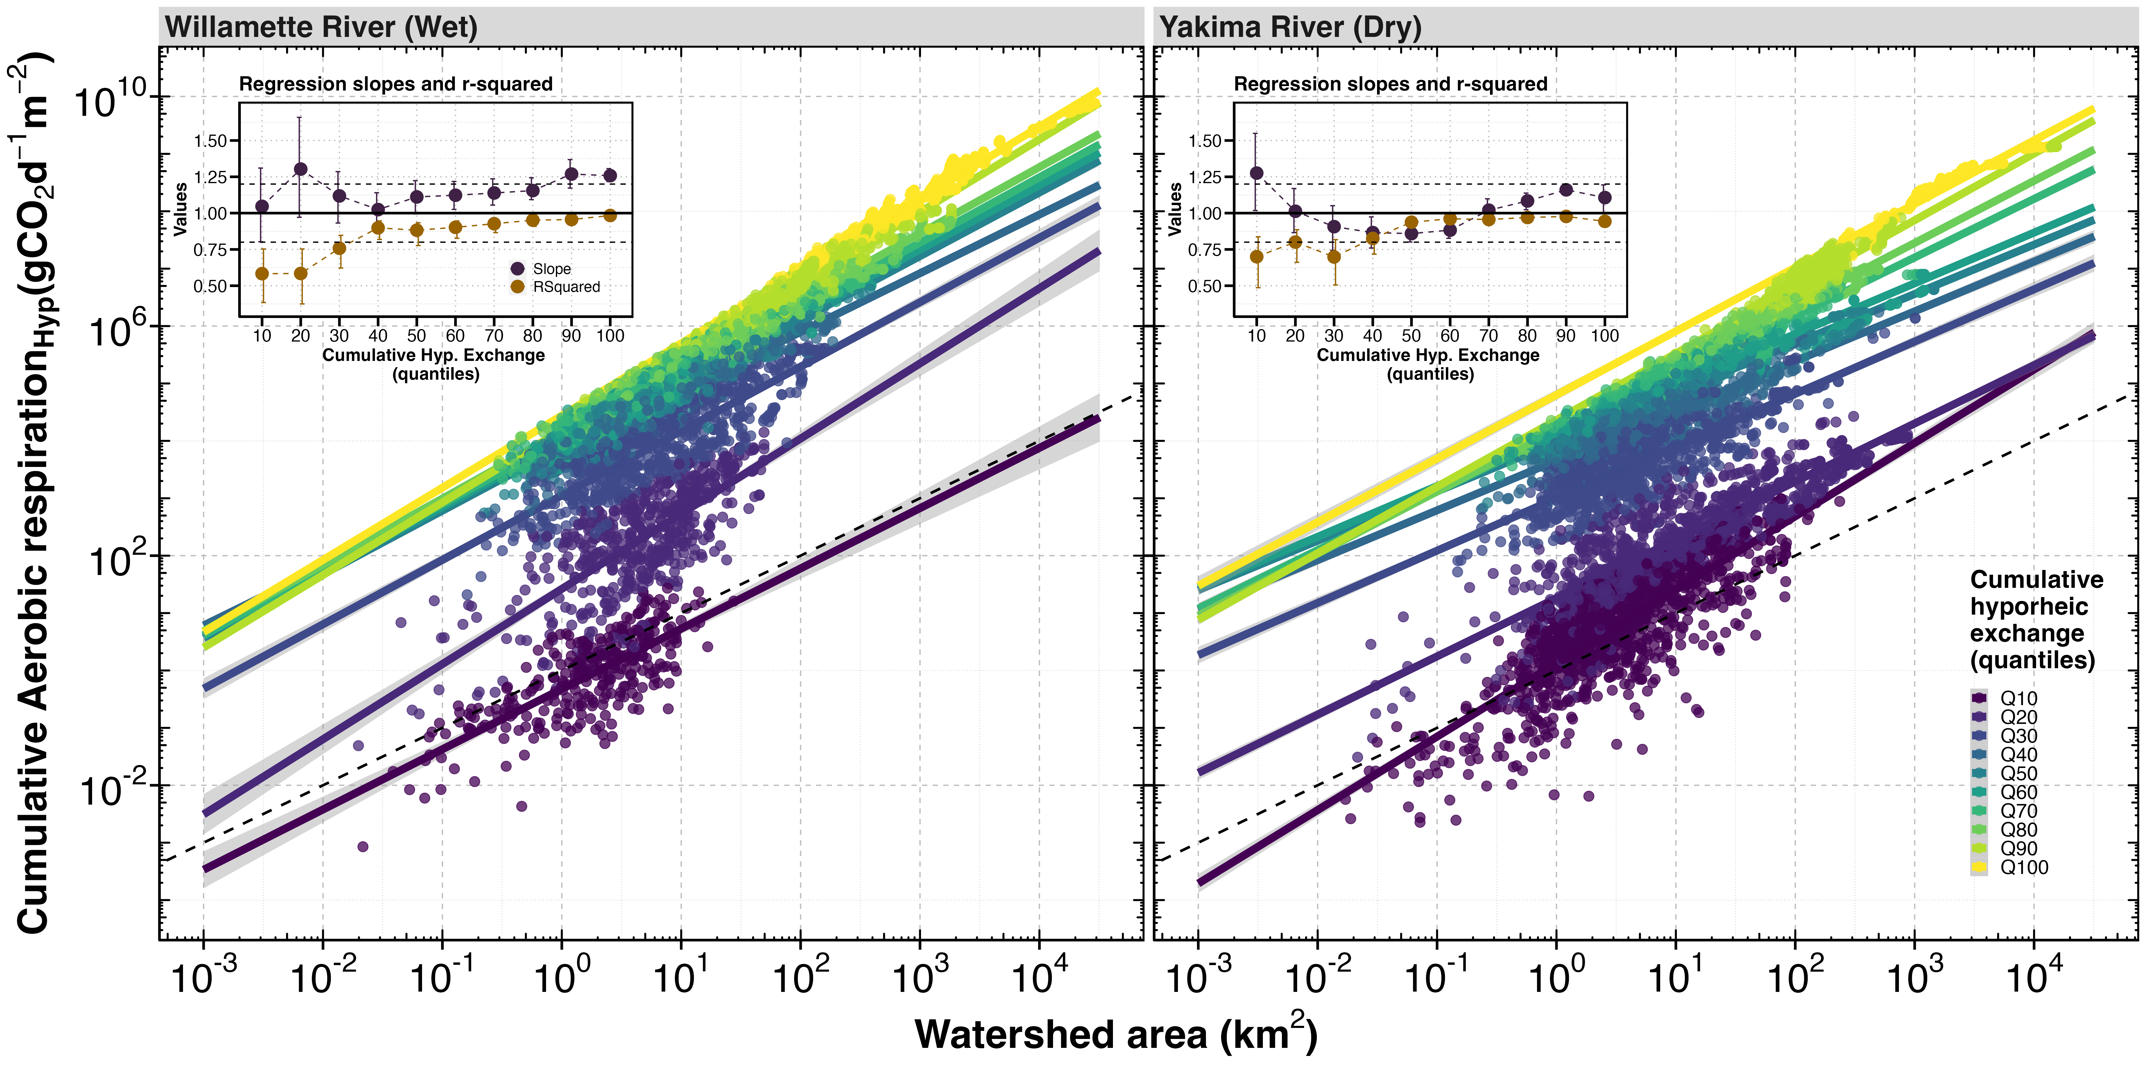
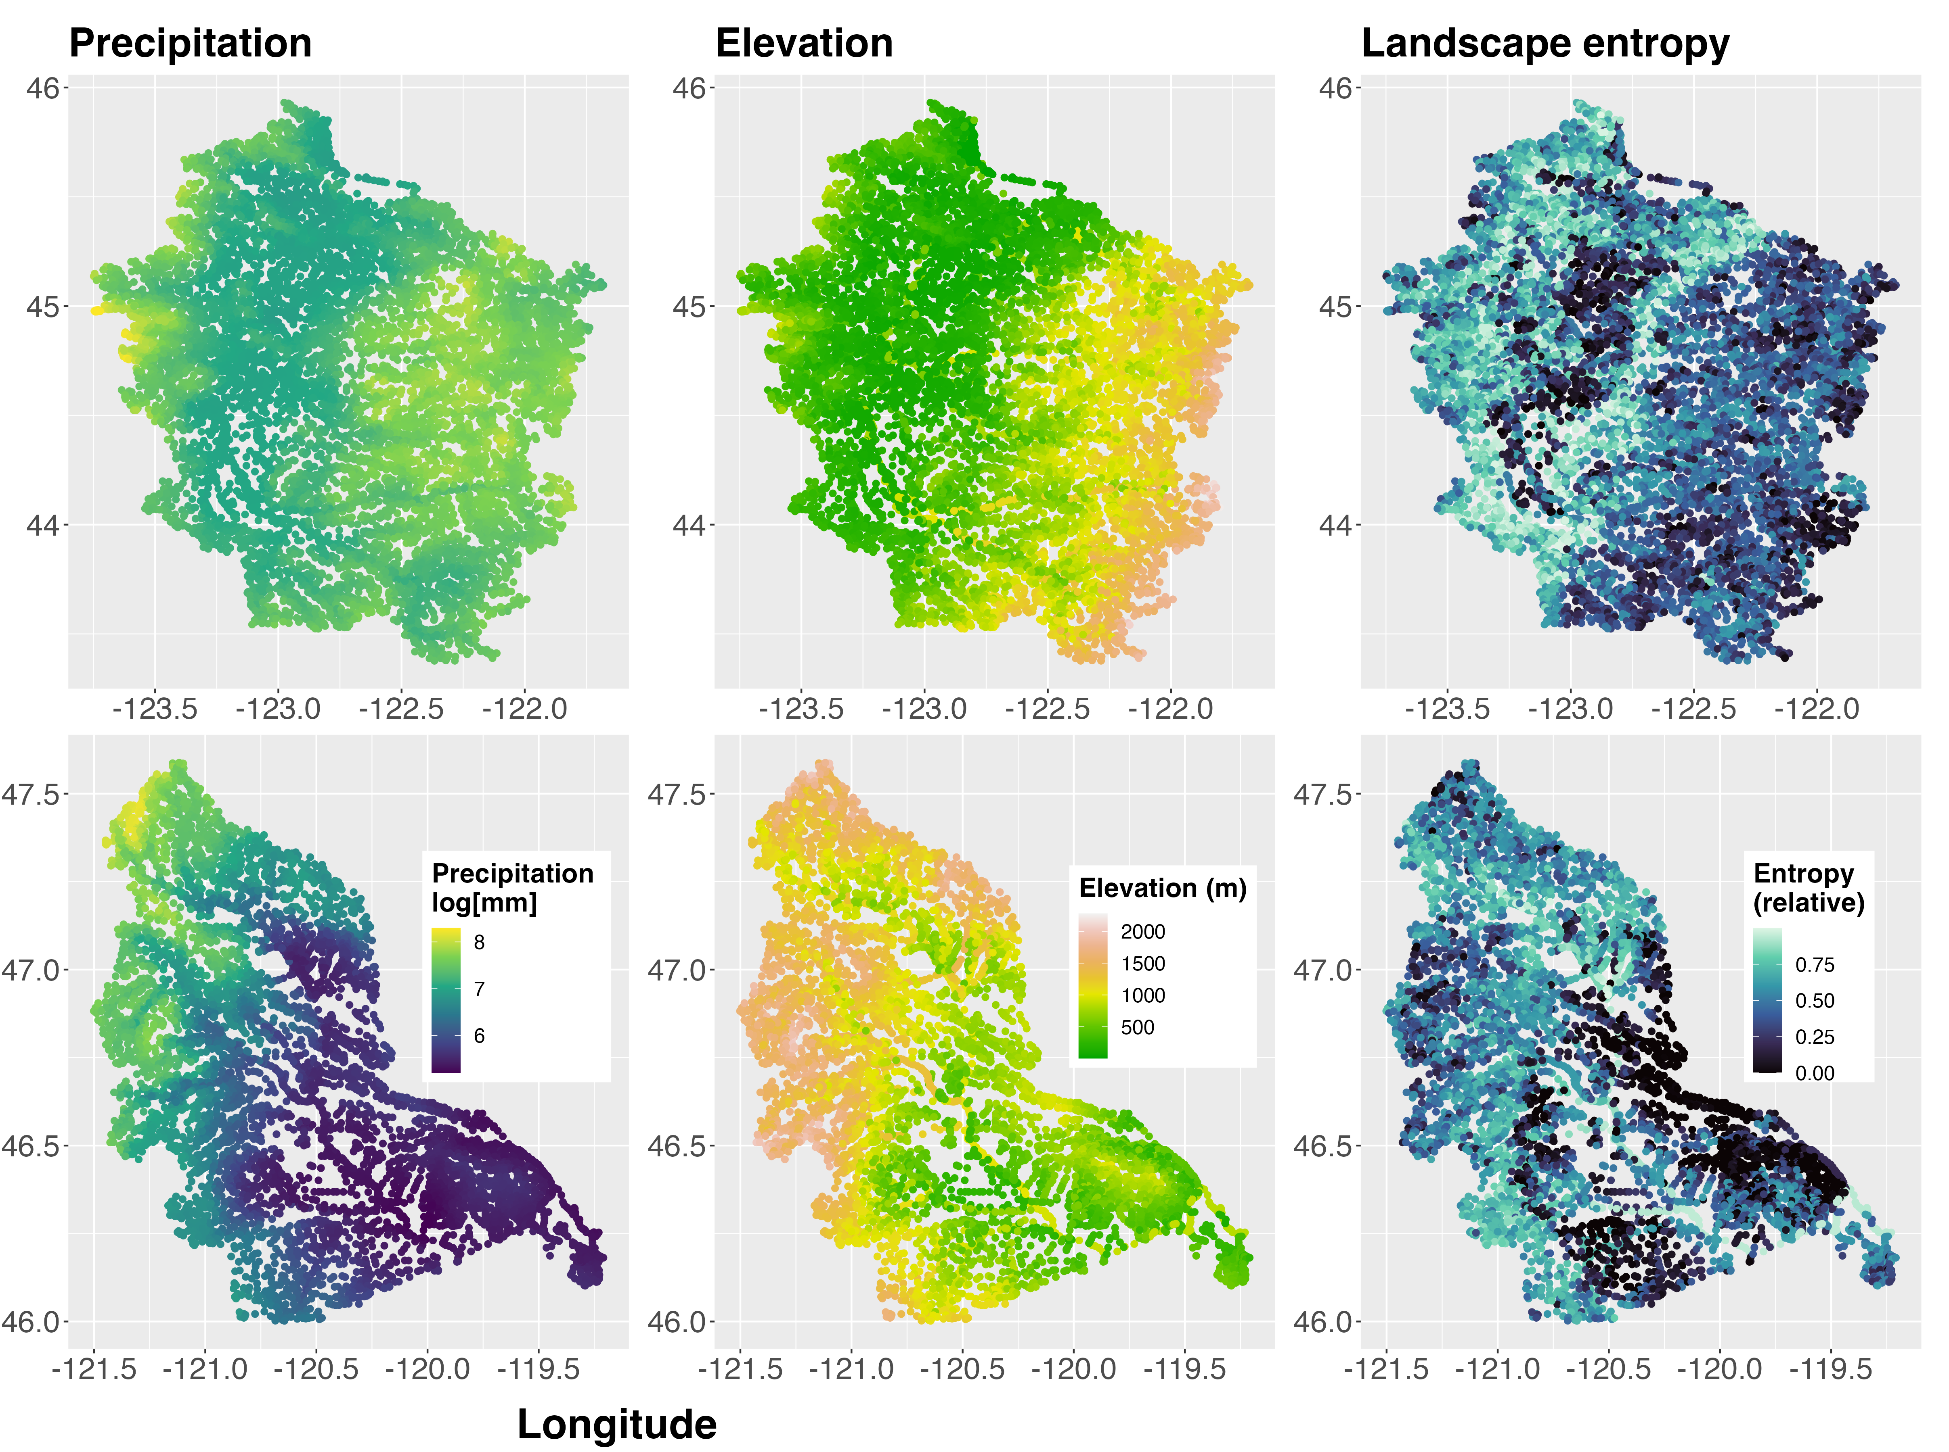
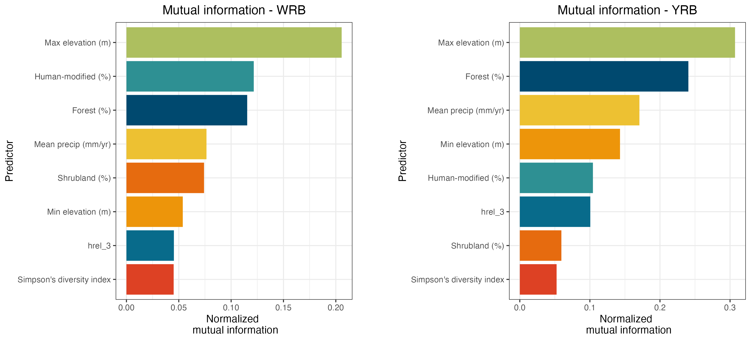
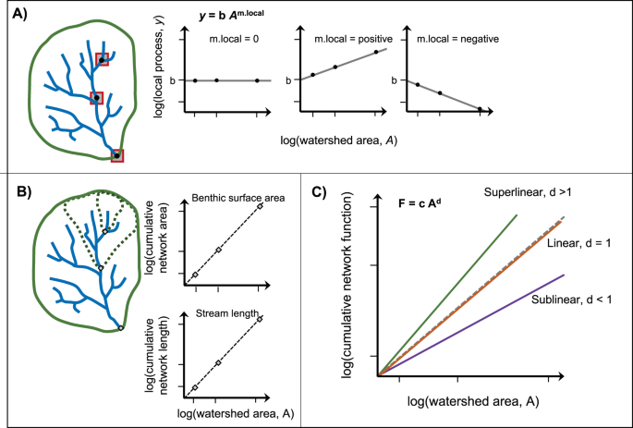
Allometric scaling of hyporheic respiration across contrasting basins in the Pacific Northwest, USA
Francisco Guerroro¹, Peter Regier², Kyongho Son³, Xingyuan Chen³, Yilin Fang³, Peishi Jiang³, Wilfred Wollheim⁴, Tim Scheibe³ and James Stegen³
1. Oregon State University, Corvallis, OR, USA, 2. Marine and Coastal Research Lab, Pacific Northwest National Laboratory, Richland, WA, USA, 3. Pacific Northwest National Laboratory, Richland, WA, USA, 4. University of New Hampshire, Durham, NH, USA.
Background and Motivation
Allometric scaling behavior across basins
Hyporheic zones: the interface between surface and groundwater) in river corridors regulate aquatic metabolism. They are temporally dynamic and spatially heterogeneous interfaces, making it difficult to predict hyporheic metabolism across scales.
Consistent patterns
Strongest allometric scaling (R2) at highest hyporheic exchange fluxes
Super-linear scaling (slope > 1) at highest exchange fluxes
Need high-res and to attribute source (stole from Tim’s poster)
Motivation: Wollheim et al. (2022) showed that ecosystem Based on recent work showing superlinear scaling of
Basin-specific patterns
Sub-linear scaling in YRB for middle exchange flux quantiles
Linear scaling: Q40 in WRB, Q70 in YRB
Study sites: Willamette and Yakima River Basins
Scaling patterns and relationships to basin characteristics
Yakima (YRB)
Consistent relationships
Maximum elevation shares the most mutual information with cumulative respiration
% Forest and annual precipitation are in the top four mutual information
YRB is drier
YRB is higher
Replace w three scapes
Willamette (WRB)
Basin-specific relationships
Human-modified land-cover shares 2nd-most mutual information with cumulative respiration in WRB, but 5th-most in YRB
Wollheim et al. (2022) Nat. Comm.
For additional information, contact:
Name | (509) XXX-XXXX | email@pnnl.gov
Notes:
NOTE: This file must print at 200% SCALE to achieve a final print size of 72” wide x 48” tall.
• Contact Digital Duplicating (375-2969, http://digitalduplicating.pnl.gov) to order poster printing and finishing services for your completed poster design.
• Remember to have your poster cleared for public display/distribution through the Information Release system (https://informationrelease.pnl.gov). A text placeholder for your poster’s Clearance Number is included in the footer.

Slide 2
Allometric scaling of hyporheic respiration across contrasting basins in the Pacific Northwest, USA
Francisco Guerroro¹, Peter Regier², Kyongho Son³, Xingyuan Chen³, Yilin Fang³, Peishi Jiang³, Wilfred Wollheim⁴, Tim Scheibe³ and James Stegen³
1. Oregon State University, Corvallis, OR, USA, 2. Marine and Coastal Research Lab, Pacific Northwest National Laboratory, Richland, WA, USA, 3. Pacific Northwest National Laboratory, Richland, WA, USA, 4. University of New Hampshire, Durham, NH, USA.
Background and Motivation
Allometric Scaling
Hyporheic zones (the interface between surface and groundwater) in river corridors regulate aquatic metabolism. They are temporally dynamic and spatially heterogeneous interfaces, making it difficult to predict hyporheic metabolism across scales.
Consistent patterns
Strongest allometric scaling (R2) at highest hyporheic exchange fluxes
Super-linear scaling (slope > 1) at highest exchange fluxes
Need high-res and to attribute source (stole from Tim’s poster)
Basin-specific patterns
Sub-linear scaling in YRB for middle exchange flux quantiles
Linear scaling: Q40 in WRB, Q70 in YRB
Allometric scaling (processes scaling with watershed area) are a valuable framework for Wollheim et al. (2022) showed consistent linear to super-linear allometric scaling of ecosystem metabolism with watershed area.
Questions
Does hyporheic metabolism scale allometrically?
Do watershed characteristics influence allometric scaling relationships?
Scaling Relationships to Ecosystem Characteristics
Consistent relationships
Maximum elevation shares the most mutual information with cumulative respiration
% Forest and annual precipitation are in the top four mutual information
Study Basins
Basin-specific relationships
Human-modified land-cover shares 2nd-most mutual information with cumulative respiration in WRB, but 5th-most in YRB
Willamette River Basin
Wetter
Lower elevation
Dominated by human and forested landcover
Yakima River Basin
Drier
Higher elevation
Dominated by shrub and forested landcover
For additional information, contact:
Name | (509) XXX-XXXX | email@pnnl.gov
Notes:
NOTE: This file must print at 200% SCALE to achieve a final print size of 72” wide x 48” tall.
• Contact Digital Duplicating (375-2969, http://digitalduplicating.pnl.gov) to order poster printing and finishing services for your completed poster design.
• Remember to have your poster cleared for public display/distribution through the Information Release system (https://informationrelease.pnl.gov). A text placeholder for your poster’s Clearance Number is included in the footer.

